Slide 1
Final Engagement
Attack, Defense & Analysis of a Vulnerable Network
Presentation by:
James Byford, Daniela Lugo, Zaid Zuhair

Slide 2
Table of Contents
This document contains the following resources:
Network Topology & Critical Vulnerabilities
Traffic Profile
Normal Activity
Malicious Activity

Slide 3
Network Topology
& Critical Vulnerabilities
‹#›

Slide 4
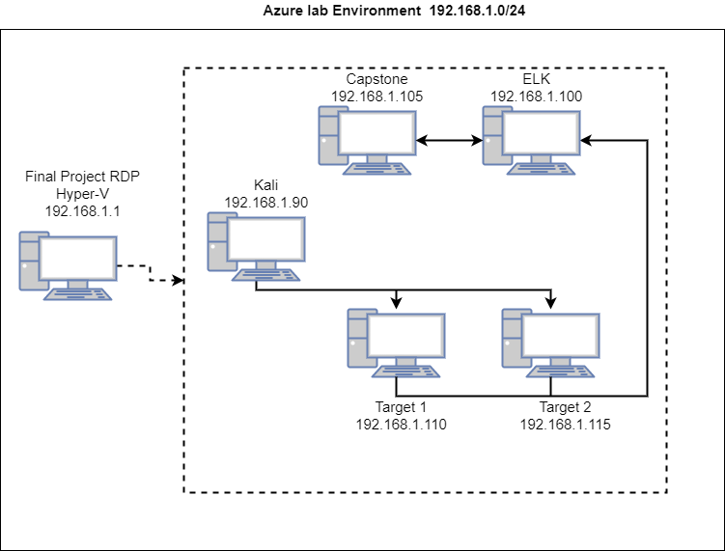
Network Topology
Network
Address Range: 192.168.1.0/24
Netmask: 255.255.255.0
Gateway: 10.0.0.1
Machines
IPv4: 192.168.1.90
OS: Linux 2.6
Hostname: Kali
IPv4: 192.168.1.100
OS: Linux Ubuntu 4.0.3
Hostname: ELK
IPv4: 192.168.1.110
OS: Linux 3.2 - 4.9
Hostname: Target 1
IPv4: 192.168.1.105
OS: Linux Ubuntu protocol 2.0
Hostname: Capstone

Slide 5
Critical Vulnerabilities: Target 1
Our assessment uncovered the following critical vulnerabilities in Target 1.
Vulnerability | Description | Impact
Nmap and User Enumeration | Using nmap we were able to discover open ports on the network. | We were able to find vulnerabilities with the open ports and plan attacks accordingly.
Weak user passwords | Easily guessed password | Gained unauthorized access to system and files
Unsalted user passwords | wpscan was utilized in order to gain username information | We were able to use the username found to gain access to the web server.
MySQL Data Exfiltration | Browsing through the MySQL database we were able to view various tables and databases from the wordpress site. | This allowed us to view the hashes for certain users passwords.
Wrong configuration of User privileges for privilege escalation | One of the users had sudo access for python. | Using sudo with python we were able to run a python script to gain a root shell.

Slide 6
Traffic Profile
‹#›

Slide 7
Traffic Profile
Our analysis identified the following characteristics of the traffic on the network:
Feature | Value | Description
Top Talkers (IP Addresses) | 172.16.4.205 166.62.111.64 10.0.0.201 | Machines that sent the most traffic.
Most Common Protocols | TCP (88.5%) UDP (11.2%) ARP (0.2%) | Three most common protocols on the network.
# of Unique IP Addresses | IPv4 - 877 | Count of observed IP addresses.
Subnets | 172.16.4.0/24 185.243.115.0/24 10.0.0.0/24 10.6.13.0/24 | Observed subnet ranges.
# of Malware Species | 2 pQBtWj & june11.dll | Number of malware binaries identified in traffic.
Notes:
You may have more than 2 subnets.

Slide 8
Behavioral Analysis
Purpose of Traffic on the Network
Users were observed engaging in the following kinds of activity.
“Normal” Activity
Watching various things on Youtube
Visiting the Sabetha Hospital website
Shopping for toys and records
Suspicious Activity
Downloaded Trojan malware
June11.dll & pQBtWJ (webhook)
Bought something from “cardboardspaceshiptoys.com”
Visited a random website “snnmnkxdhflwgthqismb.com”
This site had multiple POST requests.
Illegal Download of “Betty_Boop_Rythm_on_the_Reservation.avi.torrent”
The ip 185.243.115.84 which is also (b569023.green.mattingsolutions.co)
This is labeled as malicious by some security vendors.

Slide 9
Normal Activity
‹#›

Slide 10
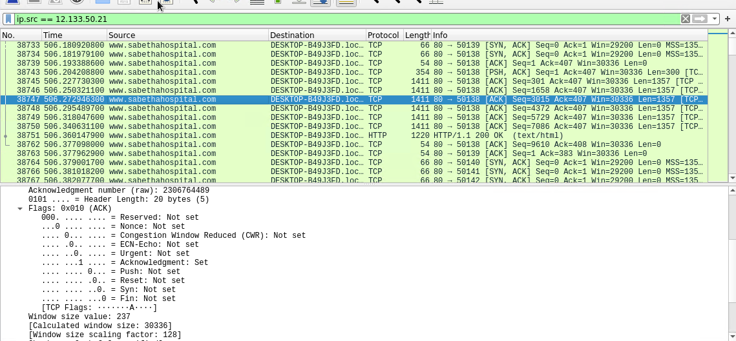
Visiting Sabetha Hospital Site
Summarize the following:
What kind of traffic did you observe? Which protocol(s)?
TCP
HTTP
What, specifically, was the user doing? Which site were they browsing?
The user visited Sabetha Hospital site (12.133.50.21)
Looking into the packets, we couldn’t find anything abnormal.

Slide 11
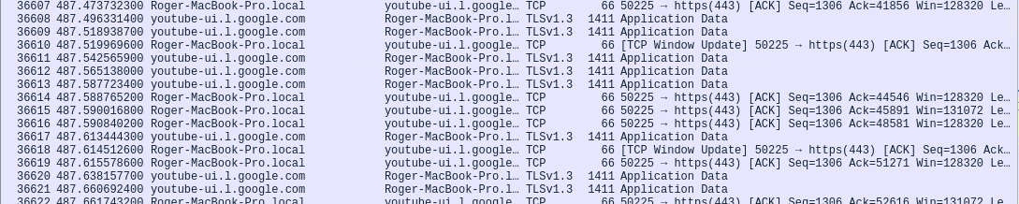
Watching Youtube
Summarize the following:
What kind of traffic did you observe? Which protocol(s)?
TCP
What, specifically, was the user doing?
The user was accessing youtube from his MacBook (Roger-Macbook-Pro - 10.11.11.179)
This communication is using TLSv1.3 that is considered secure.

Slide 12
Malicious Activity
‹#›

Slide 13
Trojan Malware
Summarize the following:
What kind of traffic did you observe? Which protocol(s)?
HTTP
TCP
What, specifically, was the user doing? Which site were they browsing?
The user made a purchase on cardboardspaceshiptoys.com
Downloaded a Trojan malware from 205.185.125.104
Multiple POST requests made to snnmnkxdhflwgthqismb.com
Include a description of any interesting files.
The user downloaded a file called “June11.dll” which was a Trojan malware.
We also found the link “http://205.185.125.104/pQBtWJ” and using virustotal.com 6 security vendors flagged this URL malicious.
Another file found was the invoice from cardboardspaceshiptoys.com.

Slide 14
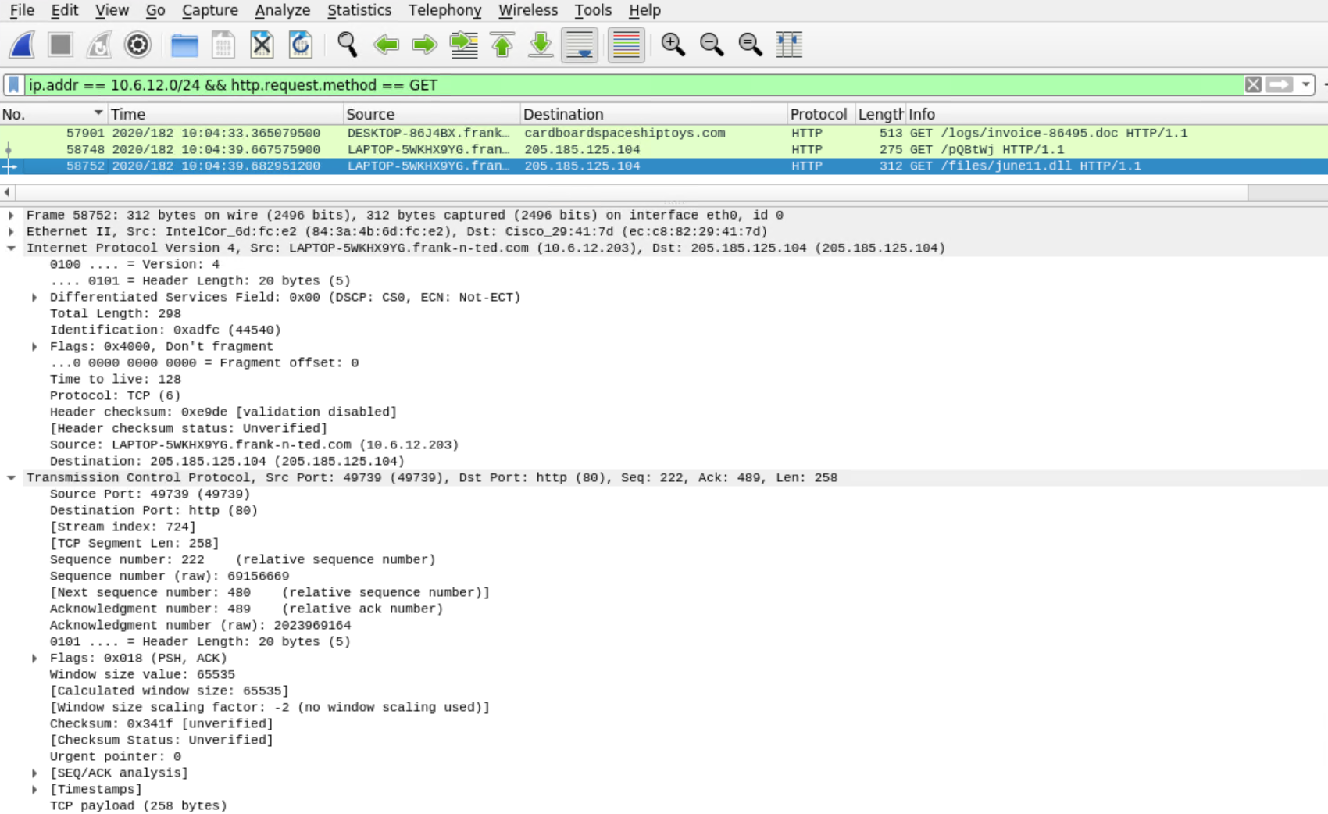
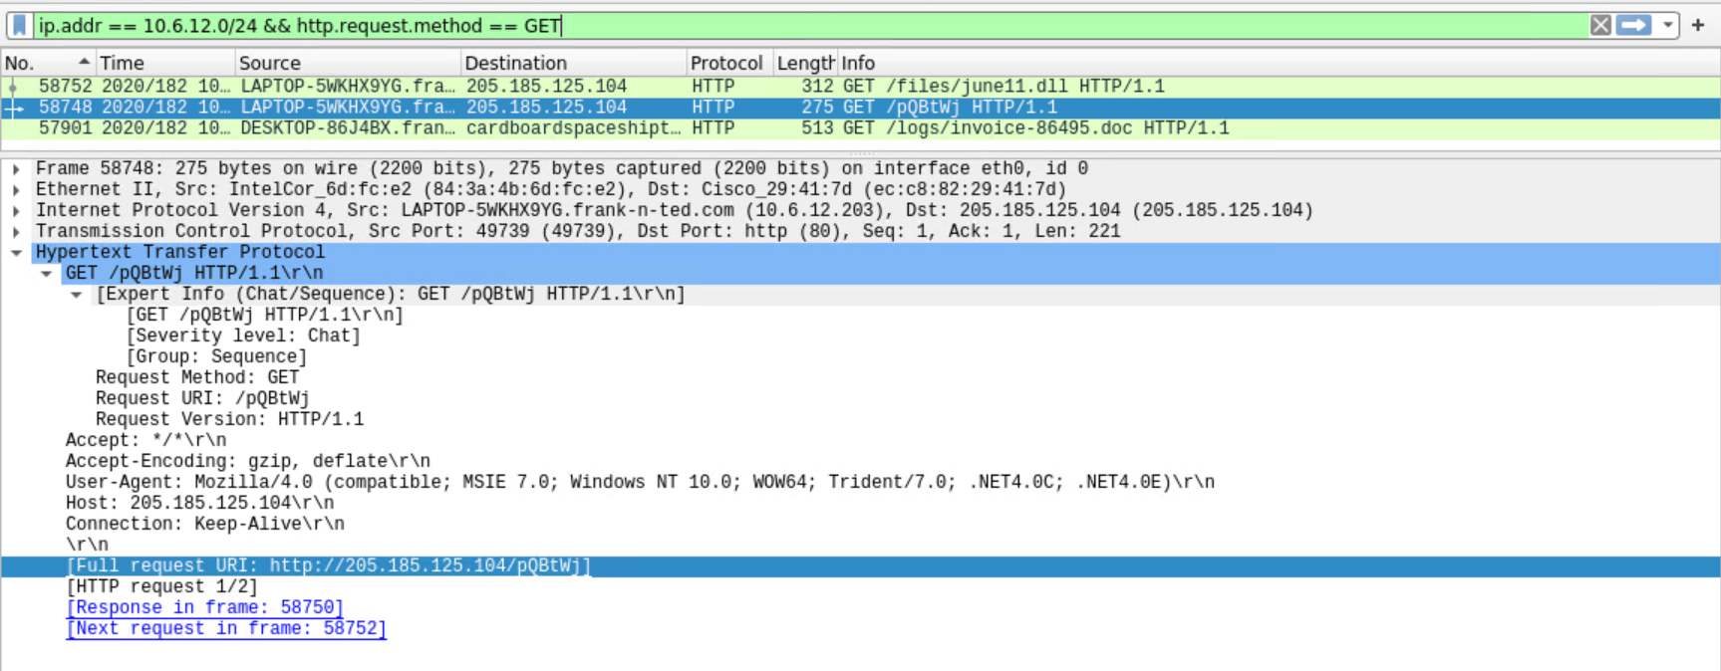
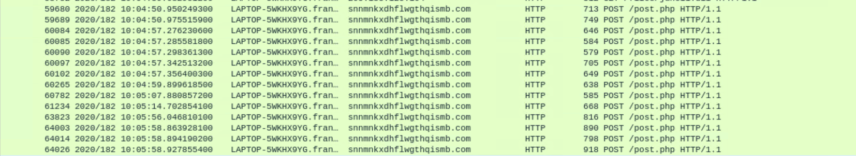
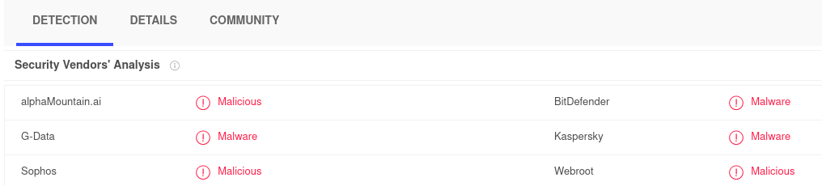
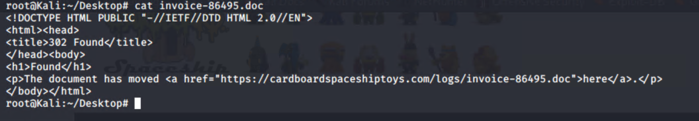
Trojan Malware Screenshots

Slide 15
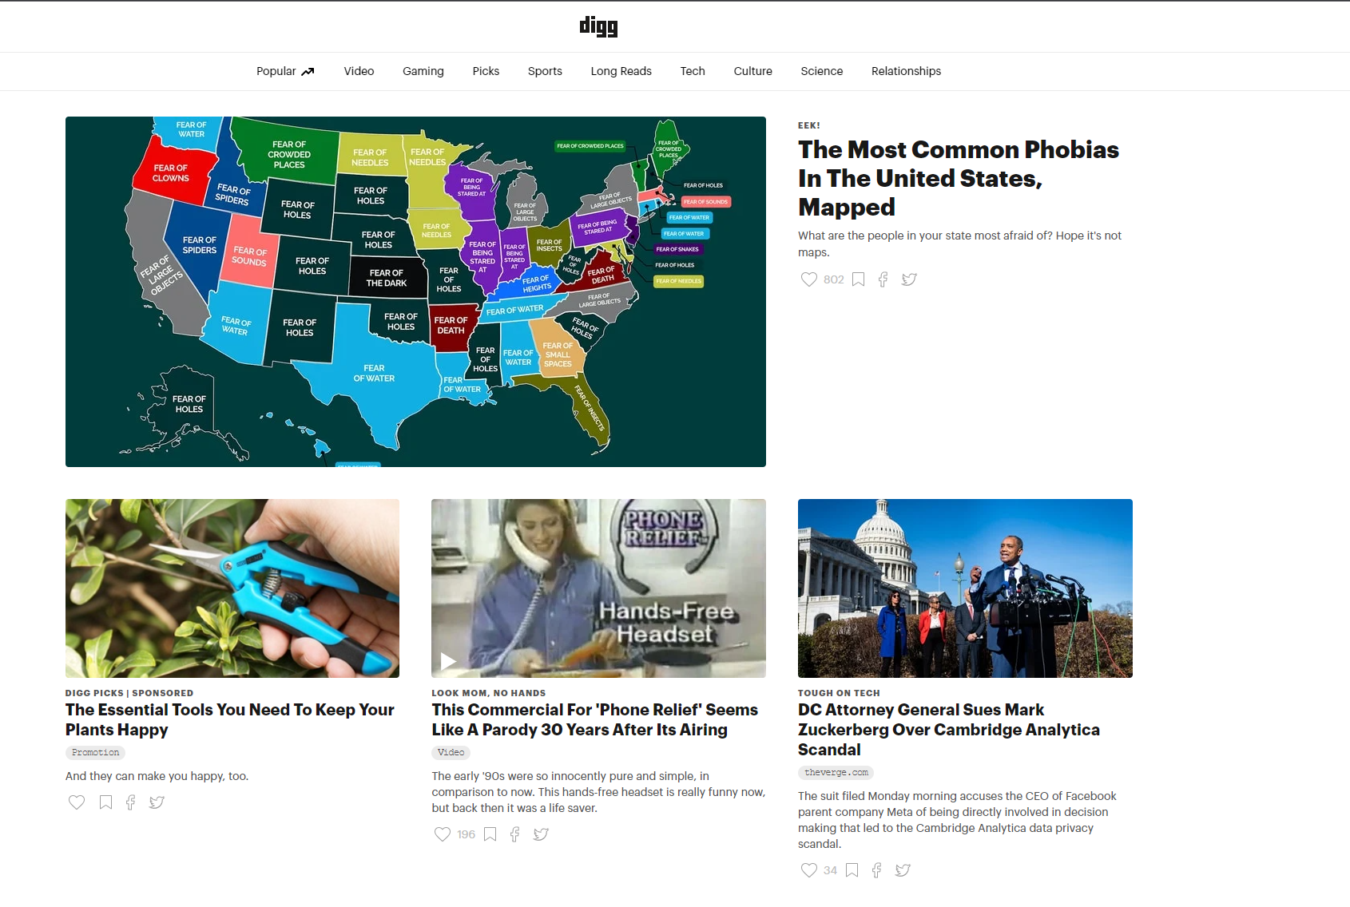
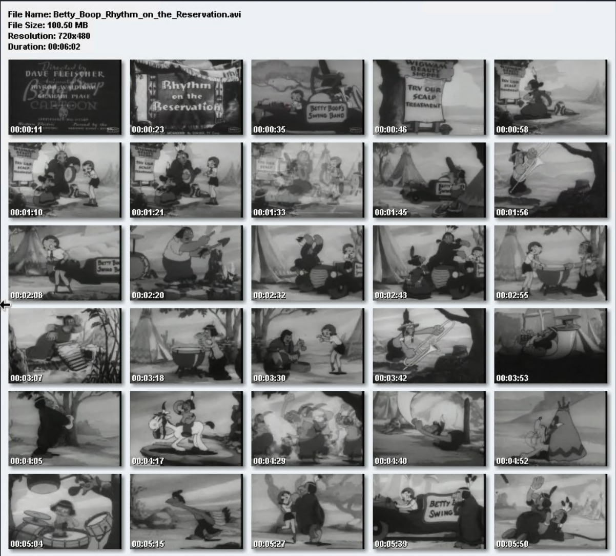
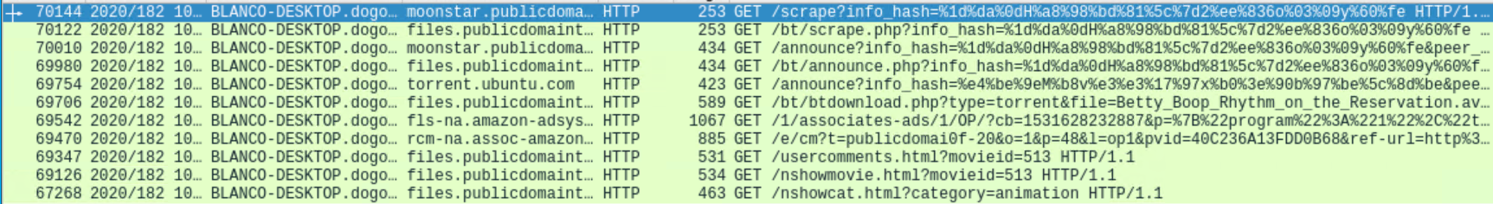
Movie Torrent
Summarize the following:
What kind of traffic did you observe? Which protocol(s)?
HTTP
TCP
UDP
What, specifically, was the user doing? Which site were they browsing? Etc.
The user was browsing for movies on “publicdomaintorrents.com”
User also visited digg.com, which is a news website.
Include a description of any interesting files.
The user downloaded a file called “Betty_Boop_Rhythm_on_the_Reservation.avi.torrent”

Slide 16
The End
‹#›

